Slide 1


Experiential Learning
Project Assessment-I
on
“QR CODE ENCODER / DECODER”
under the course
Python ProgrammingLanguage(N-PCCCM304P)
Presented By:
Kanak Bhimte
[CM25021]
Under the Guidance of
Mrs. Mayuri Getme
Session:2026-27 (ODD )
Department of CSE(AI&ML)
S. B. JAIN INSTITUTE OF TECHNOLOGY MANAGEMENT AND
RESEARCH,NAGPUR
An Autonomous Institute, Affiliated to RTMNU, Nagpur
)

Slide 2
1. Problem Statement
  Develop a simple Python system to generate QR codes from text or URLs.
  Decode and display information stored in QR code images.
  Make the process quick, simple, and easy for users.
  Reduce the need for separate tools for QR code generation and decoding.

Slide 3
2. Objective
• To generate QR codes from text or URLs.
• To decode information from QR code images.
• To make QR code generation and decoding simple.
• To save and reuse generated QR codes.
• To understand the practical use of Python libraries.
.

Slide 4
3. Algorithm
1. Start the program.
2. Display two options: Encode and Decode.
3. Ask the user to select an option.
4. If Encode is selected:
5. Enter text or a URL.
6. Generate the QR code.
7. Save the QR code as an image.
8. If Decode is selected:
9. Select/read the QR code image.
10. Detect the QR code.
11. Extract the stored information.
12. Display the decoded data.
13. If an invalid option is selected, display an error message.
14. Stop the program.

Slide 5
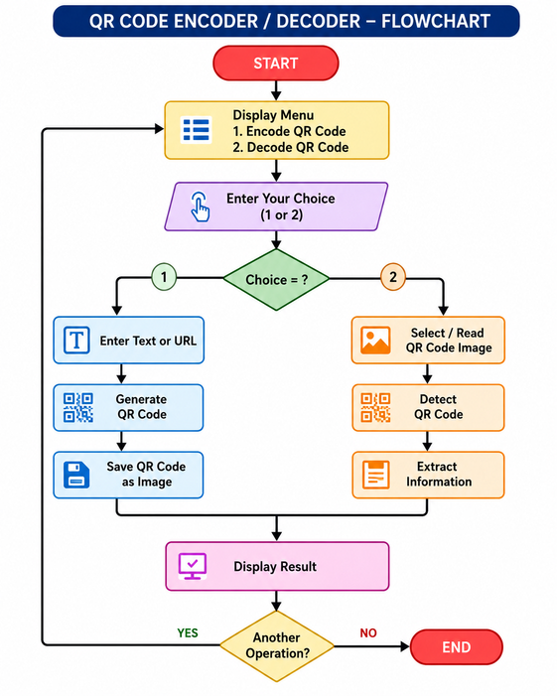
4. Flowchart

Slide 6
5. Understanding of python logic
• Takes input from the user.
• Uses if-else conditions to select Encode or Decode.
• Performs the required operation based on the selected option.
• Generates a QR code when Encode is selected.
• Reads and extracts data when Decode is selected.
• Displays the final result to the user.
• Shows an error message for an invalid choice.

Slide 7
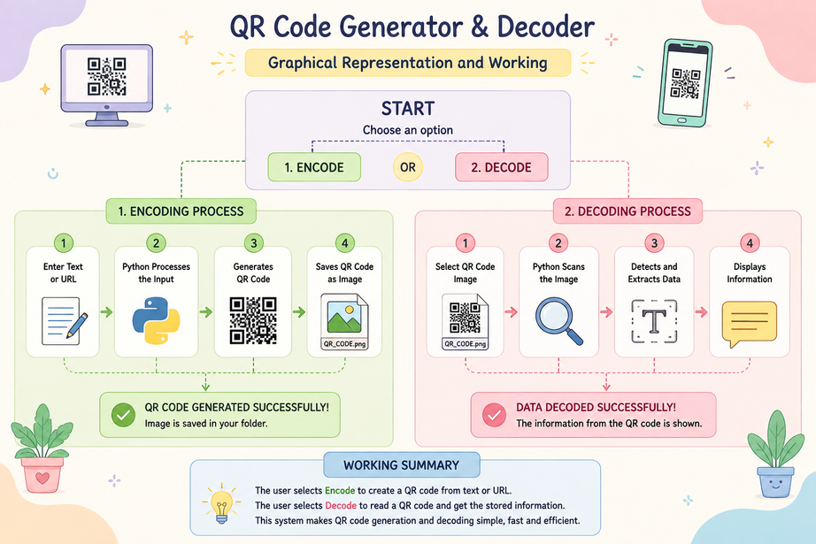
6. Graphical Representation and Working

Slide 8
7. GitHub Account, Repository & Collaboration
• Created a GitHub repository to store the QR Code
Encoder/Decoder project.
• Uploaded the Python source code to the repository.
• Used GitHub to keep the project organized and accessible.
• Changes and updates can be tracked using commits.
• Team members can collaborate by sharing and updating the repository.
• GitHub helps maintain a backup and version history of the project.

Slide 9
8. Individual Contribution
● ● ● ● ● ●
Problem Analysis – Understood the library indexing problem.
Algorithm Design – Developed the steps for the hash table system. Python Coding – Implemented the library operations in Python.
Testing – Tested insertion, searching, and deletion.
GitHub Contribution – Uploaded code and made meaningful commits. Documentation & PPT – Prepared project documentation and presentation slides.

Slide 10
Thank You
“QR CODE ENCODER / DECODER”
Presentation by- Kanak Bhimte (CM25021)

